Slide 1
Object Localisation
Group G9

Slide 2

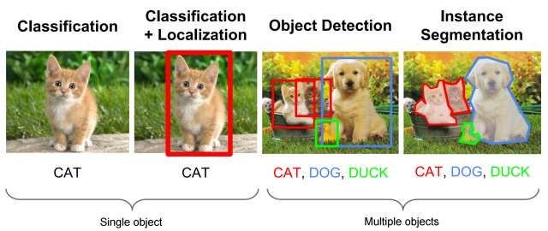

Introduction
Object Localisation is the task of finding objects in images and describing them using rectangles.
Given an image, an object localisation model should output co-ordinates which describe the size and location of each object in the image.
In our Project we combine the localisation task with the task of classification.
Hence the aim of our model is to both locate objects and label what the object is.
This task is known as object detection.

Slide 3
Project Structure
We split the project into the following structure:
1. Describe the dataset
2. Research and Create Models
3. Model tuning
4. Collecting results and analysis

Slide 4
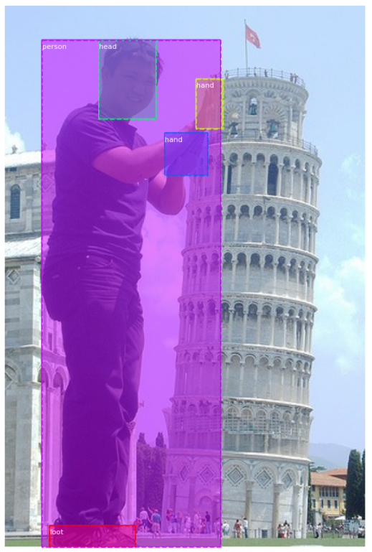
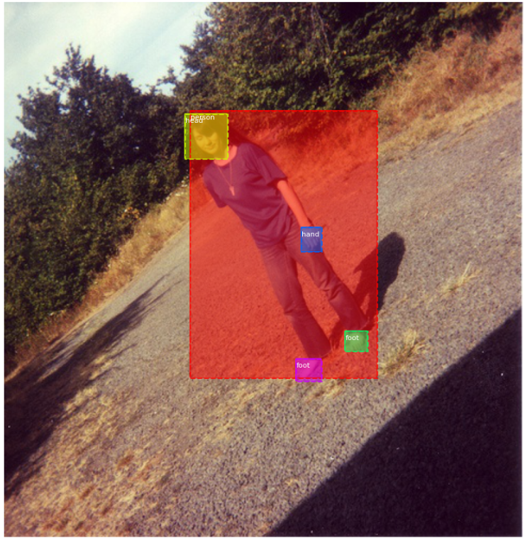
Description of the dataset
The first task involved looking at the dataset provided and choosing what images we would use.
From here we decided to perform the task of object detection using images of people.
We would try to locate and classify the following objects:
People, Heads, hands and Feet.

Slide 5
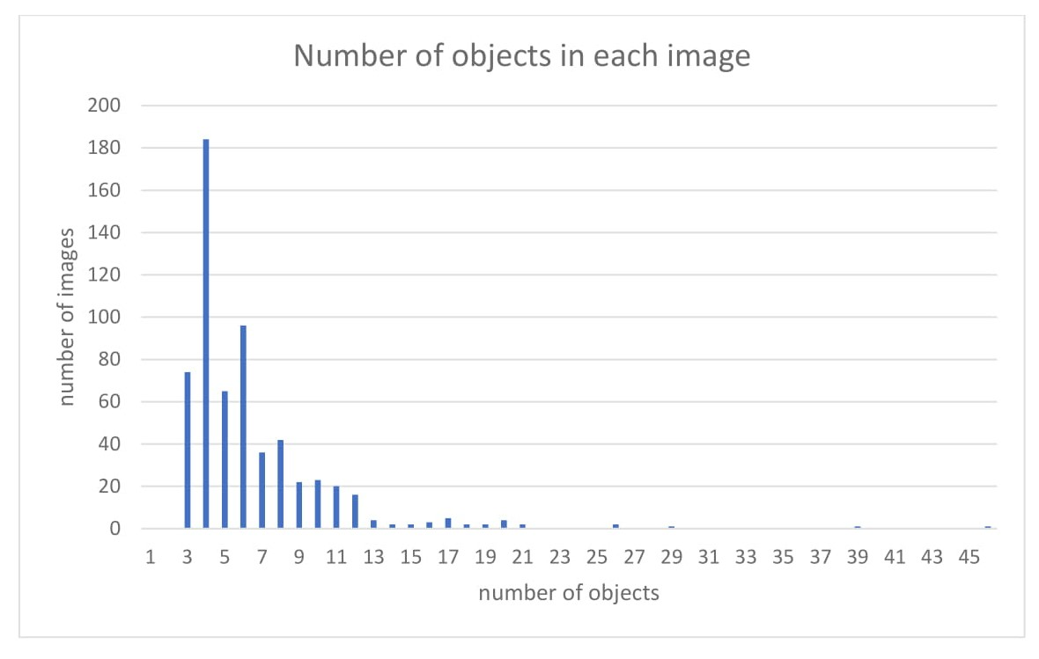
Analysis of the dataset
Analysis of the annotations for the images, showed that there were other labelled objects, sofas, chairs, tables, etc … inside the images.
These were removed as they did not fit with our objective and there were not enough instances of them to train a model.
We also analysed the number of images that contained
different numbers of objects.
This allowed us to find if there were any images with many
objects and hence any images that may be difficult
to perform accurate object detection

Slide 6
Researched Methods
Simple CNN : Used for exploring underlying techniques
Mask R-CNN :
Maybe:
YOLO :
Xception :

Slide 7
Chosen Method / Literature Review
Mask R-CNN: Theory and Implementation

Slide 8
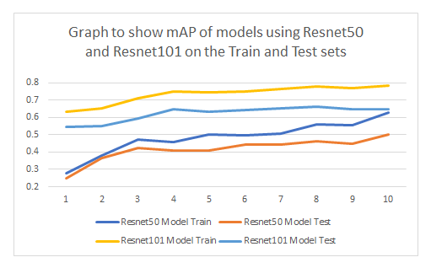
Mask R-CNN Experimental setting
Here the aim was to increase the performance of the model by tuning different parameters.
This included:
. Loss Weights
. Learning rate / Momentum
. Regularisation parameter
. Model Layers
. Model Backbone

Slide 9
Results and Analysis

Slide 10
Conclusion

